Slide 1

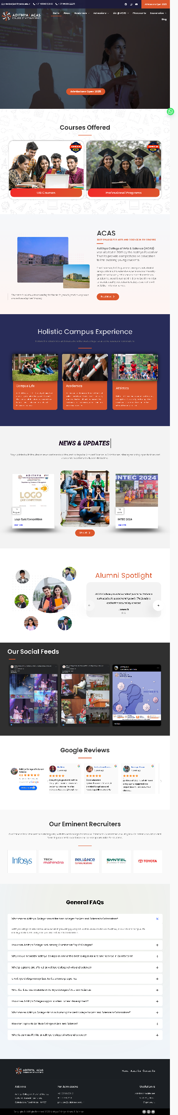
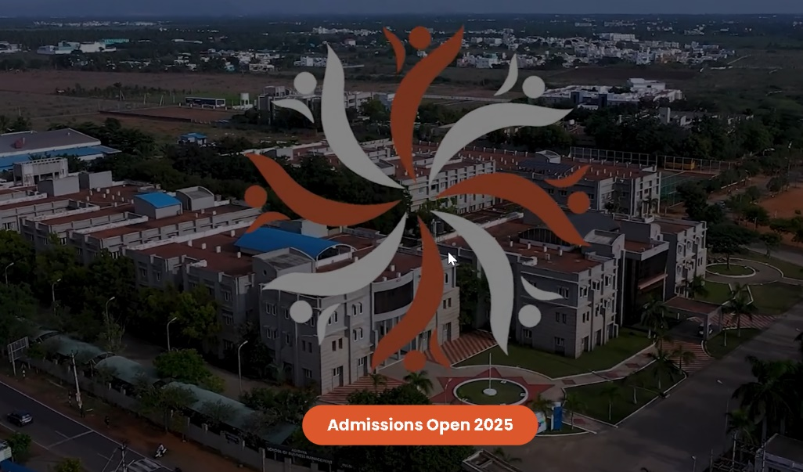

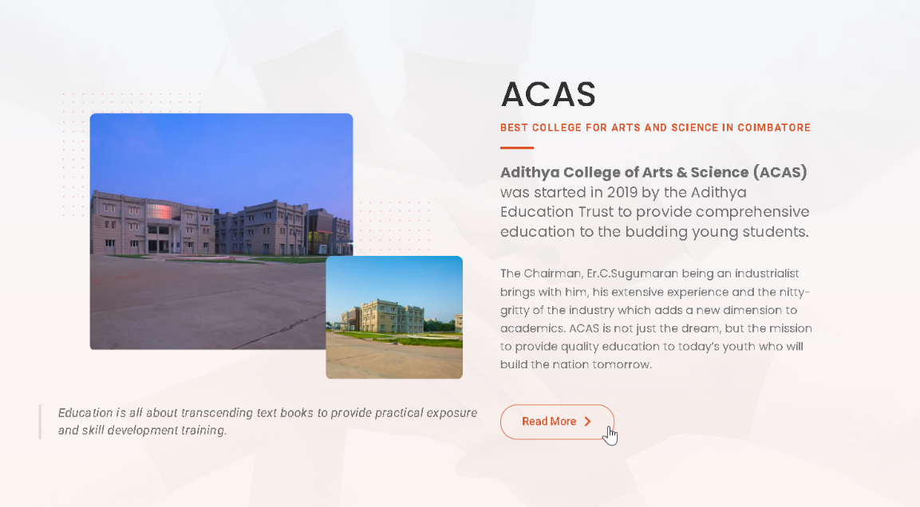
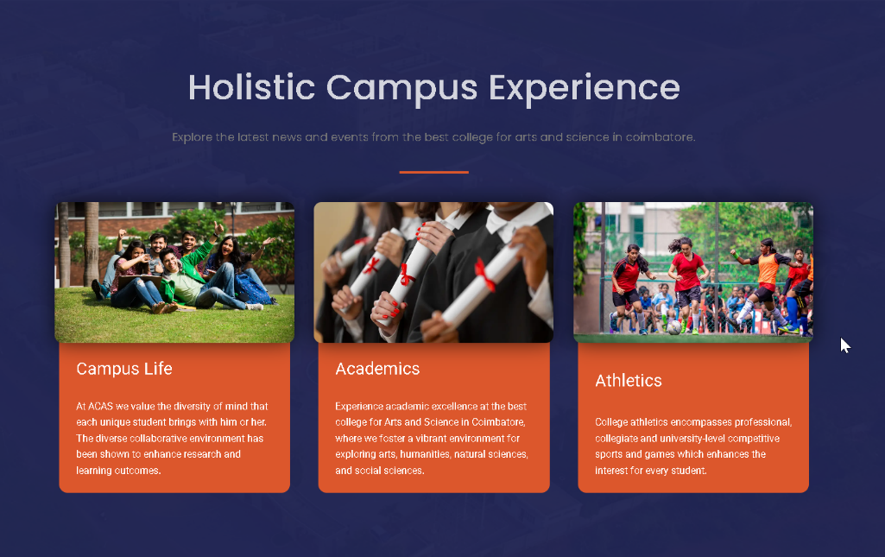
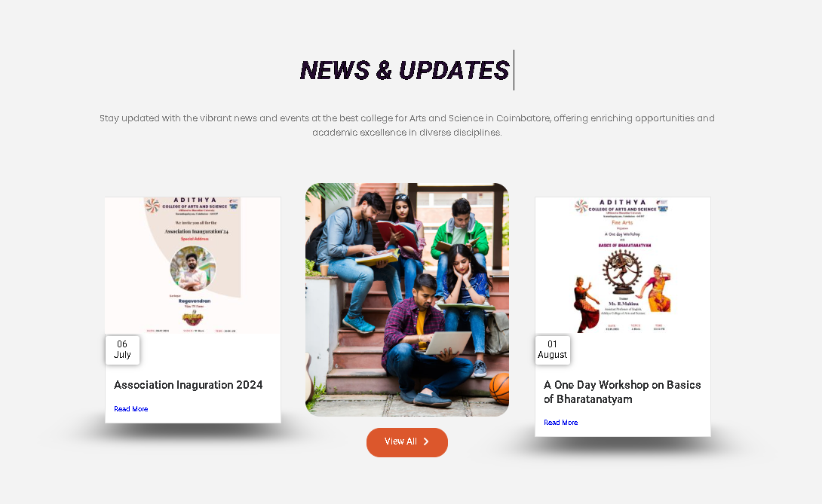

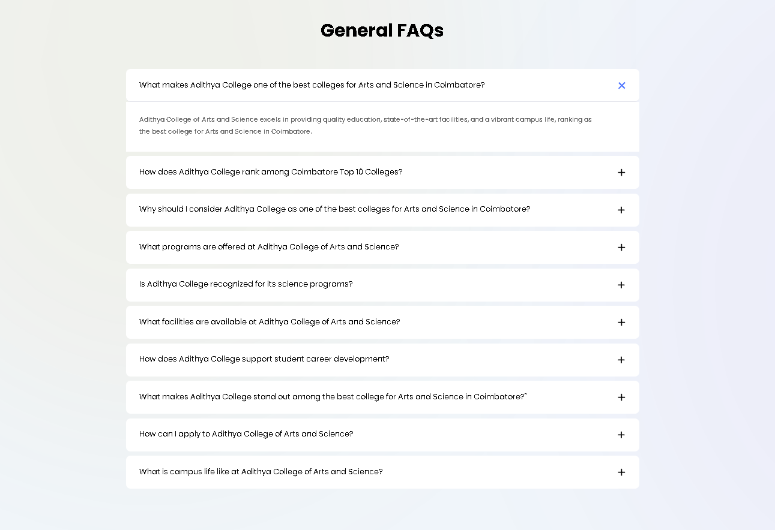
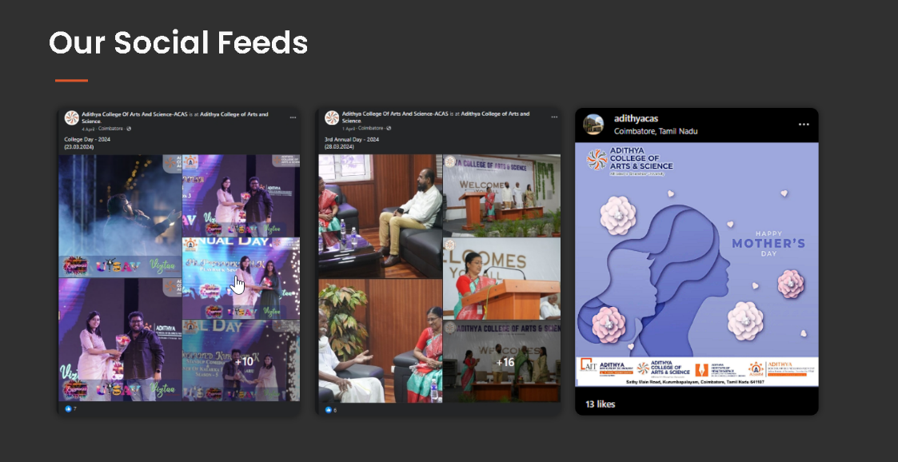
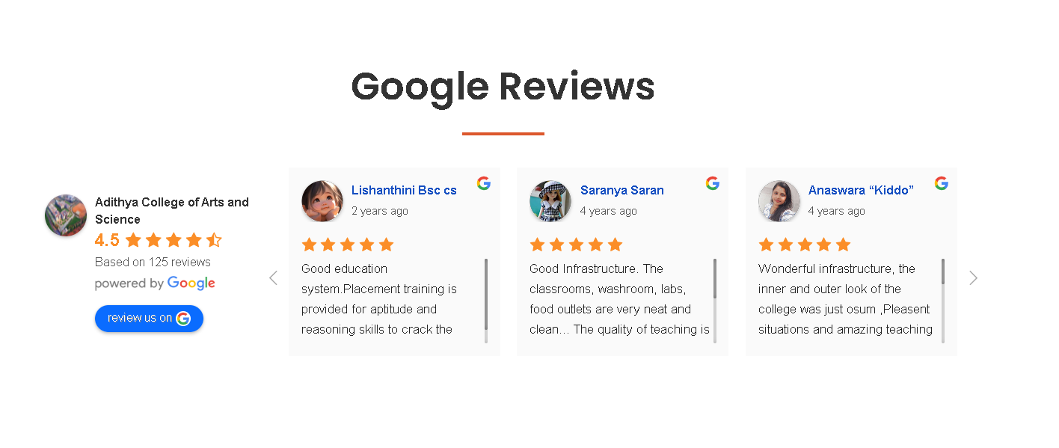

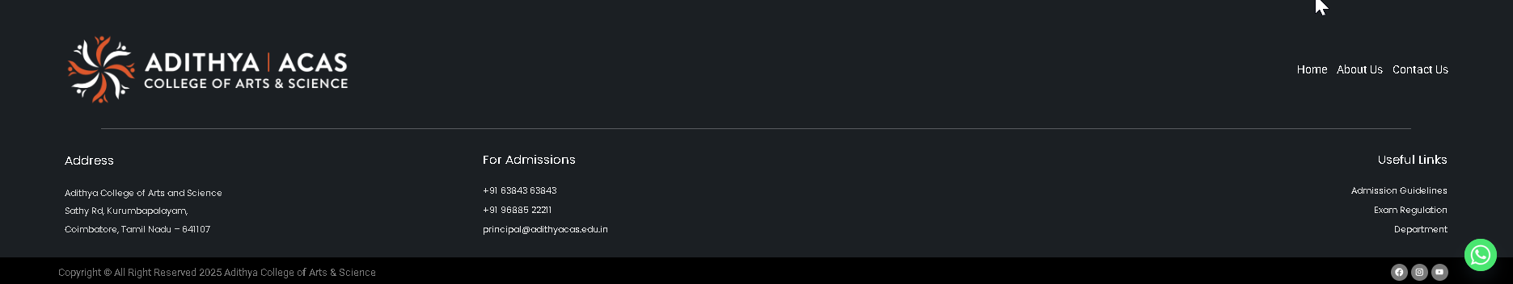
college_website (Components)
1_navBar
12
2_hero
3_courses
4_acas
7_alumni
5_holistic
6_news
8_feeds
9_reviews
10_faqs
11_eminent
12_contact

Slide 2
college_website (Components)
1_navBar
component

Slide 3
college_website (Components)
1_navBar
row

Slide 4
college_website (Components)
1_navBar
column

Slide 5
college_website (Components)
1_navBar
subColumn

Slide 6


college_website (Components)
2_hero
component

Slide 7
college_website (Components)
2_hero
row

Slide 8
college_website (Components)
2_hero
column

Slide 9
college_website (Components)
2_hero
subColumn

Slide 10

college_website (Components)
3_courses
component

Slide 11
college_website (Components)
3_courses
row

Slide 12
college_website (Components)
3_courses
column

Slide 13
college_website (Components)
3_courses
subColumn

Slide 14

college_website (Components)
4_acas
component

Slide 15
college_website (Components)
4_acas
row

Slide 16
college_website (Components)
4_acas
column

Slide 17
college_website (Components)
4_acas
subColumn

Slide 18


college_website (Components)
5_holistic
component

Slide 19
college_website (Components)
5_holistic
row

Slide 20
college_website (Components)
5_holistic
column

Slide 21
college_website (Components)
5_holistic
subColumn

Slide 22
college_website (Components)
6_news
component

Slide 23
college_website (Components)
6_news
row

Slide 24
college_website (Components)
6_news
column

Slide 25
college_website (Components)
6_news
subColumn

Slide 26

college_website (Components)
7_alumni
component

Slide 27
college_website (Components)
7_alumni
row

Slide 28
college_website (Components)
7_alumni
column

Slide 29
college_website (Components)
7_alumni
subColumn

Slide 30
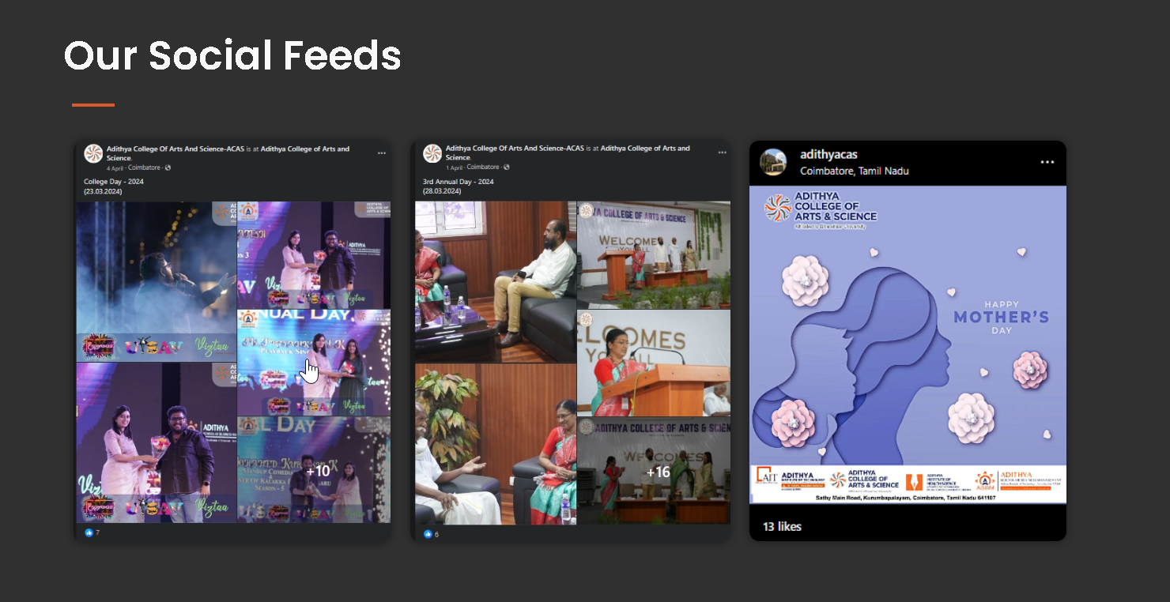
college_website (Components)
8_feeds
component

Slide 31
college_website (Components)
8_feeds
row

Slide 32
college_website (Components)
8_feeds
column

Slide 33
college_website (Components)
8_feeds
subColumn

Slide 34
college_website (Components)
9_reviews
component

Slide 35
college_website (Components)
9_reviews
row

Slide 36
college_website (Components)
9_reviews
column

Slide 37
college_website (Components)
9_reviews
subColumn

Slide 38

college_website (Components)
10_eminent
component

Slide 39
college_website (Components)
10_eminent
column

Slide 40
college_website (Components)
10_eminent
subColumn

Slide 41
college_website (Components)
11_faqs
component

Slide 42
college_website (Components)
11_faqs
row

Slide 43
college_website (Components)
11_faqs
column

Slide 44
college_website (Components)
11_faqs
subColumn

Slide 45
college_website (Components)
12_contact
component

Slide 46
college_website (Components)
12_contact
row

Slide 47
college_website (Components)
12_contact
column

Slide 48
college_website (Components)
12_contact
subColumn

